Slide 1
Crop Yield Prediction using Machine Learning
NAME: D SRAVYA
ROLE: DATA SCIENCE INTERN
Submitted to:
LEARN AND BUILD

Slide 2
INTRODUCTION:
Introducing our advanced Machine Learning (ML) Model for crop yield prediction and decision support in precision agriculture. With a focus on optimizing crop productivity and maximizing profits for farmers, our model integrates multiple datasets, including climate, weather, soil, fertilizer usage, pH levels, and seed variety. Through the utilization of various ML algorithms, our model accurately predicts crop yields and offers valuable prescriptions during the growing season, guiding farmers on the optimal choice of crops and necessary actions for increased productivity. By leveraging past experiences and historical data, our model is designed to continually improve its performance, providing farmers with valuable insights and recommendations to enhance their overall agricultural output and economic gains.
MOTIVATION:
Optimizing Crop Productivity: Increasing crop productivity is a crucial goal for farmers, as it directly impacts their profits and sustains agricultural viability. By using our ML model, farmers can gain valuable insights into factors that affect crop yields, enabling them to make informed decisions for enhanced productivity.
Complexity of Crop Yield Prediction: Crop yield prediction involves a myriad of interconnected variables, making it a complex task. Our model's ability to process and analyze diverse datasets enables a comprehensive understanding of these factors, facilitating precise predictions and empowering farmers to make strategic choices.
Financial Gain for Farmers: By providing accurate yield predictions and tailored prescriptions, our ML model helps farmers make strategic choices that optimize their resources and maximize profits. Improved crop productivity directly translates into increased revenue and improved livelihoods for farmers.

Slide 3
Introduction to the data:
The datasets used in this project to predict crop yield are:
State Wise Major Crop Production:
Crop Dependence on Various Factors:
Ideal value of pH for various crops :
State Wise Cost of Production:
Actual Crop Yield based on Various Factors
The key features involved in this project are:
Climate and Weather Data: Historical weather patterns, including temperature, precipitation, humidity, wind speed, and other relevant climate factors, play a vital role in crop growth and yield. This data helps the model understand how different weather conditions impact crop development.
Climate features: The factures like temperature,ph,humidity and rainfall plays a major role to predict weather conditions for the growth of crop.
Crop production:This data include particular place,whether condition and major crop grown .

Slide 4
Highlights from EDA:
Crop Dependency Analysis: Examined the relationship between crop production and various factors like climate, weather, soil characteristics, fertilizer usage, or seed varieties. statistical analysis, such as correlation or regression, to quantify the impact of these factors on crop yields.
Ideal pH Values: The dataset containing the ideal pH values for various crops. Analyzed the distribution of pH values and identified the optimal pH range for each crop. This information can be helpful in providing recommendations for adjusting soil pH levels for improved productivity.
Cost of Production Analysis:From the analysis of "State Wise Cost of Production" dataset to understand the financial aspects of crop cultivation. Identifed the cost components, such as labor, seeds, fertilizers, and machinery, and assess their impact on crop profitability.
Actual Crop Yield Analysis: The relationship between crop yields and factors such as climate, weather, soil, and agricultural practices. This analysis can help validate the predictive power of the ML model and identify areas for improvement.

Slide 5
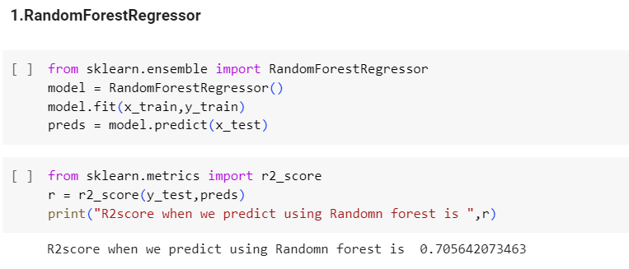
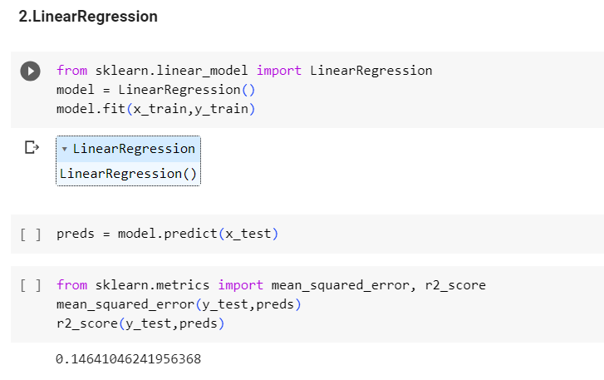
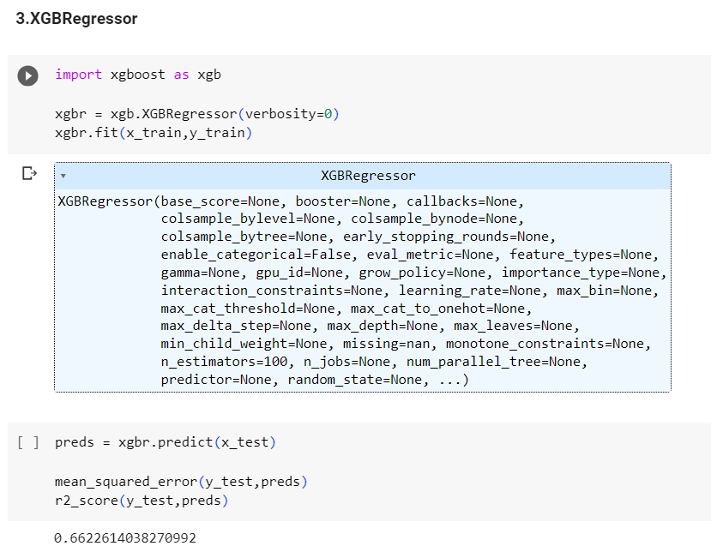
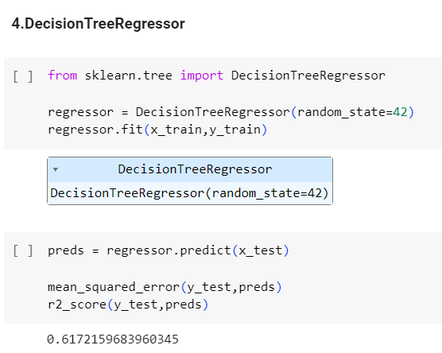
Final Modal:
Following are the results from various models:

Slide 6
Interesting findings from the model:
The ML model could reveal the relative importance of various factors affecting crop yield, such as weather conditions, soil quality, fertilizer usage, and seed variety. This insight can help farmers prioritize actions for maximizing productivity.
By combining data from different sources, the model identified regions ideally suited for specific crops based on climate, soil, and historical yield performance. This insight can guide farmers in making informed decisions on crop selection.
The model's ability to accurately predict crop yields based on historical data and various factors would provide farmers with a reliable tool for planning and making strategic decisions.

Slide 7
CONCLUSION:
In conclusion, the development and application of an advanced Machine Learning (ML) Model for crop yield prediction and decision support in precision agriculture hold significant promise for enhancing farmers' productivity and profitability. The model's ability to leverage multiple datasets, including climate, weather, soil, fertilizer usage, pH values, seed variety, and actual crop yield data, allows it to make accurate predictions and offer valuable prescriptions during the growing season.
FUTURE WORK:
Integration of Remote Sensing Data: Incorporating remote sensing data, such as satellite imagery and drones, can provide real-time information on crop health, growth, and stress factors. Integrating this data with the existing datasets can enhance the model's accuracy and enable more timely and precise recommendations.
Real-Time Monitoring and Decision Support: Building a real-time monitoring system that continuously collects data and updates the model can provide farmers with instant insights and actionable recommendations during the growing season, enabling proactive decision-making.
THANK YOU

